Slide 1
Professional Studies Assignment

Slide 2


Slide 3
Step 1
Think about specific students in your classes that face barriers to learning, then choose a topic:

Slide 4


Slide 5
A) Disengagement
or behaviour management

Slide 6


Slide 7
B) SEND

Slide 8


Slide 9
C) Stretch and Challenge

Slide 10


Slide 11
D) EAL

Slide 12
Step 2
Read about your topic.

Slide 13


Slide 14
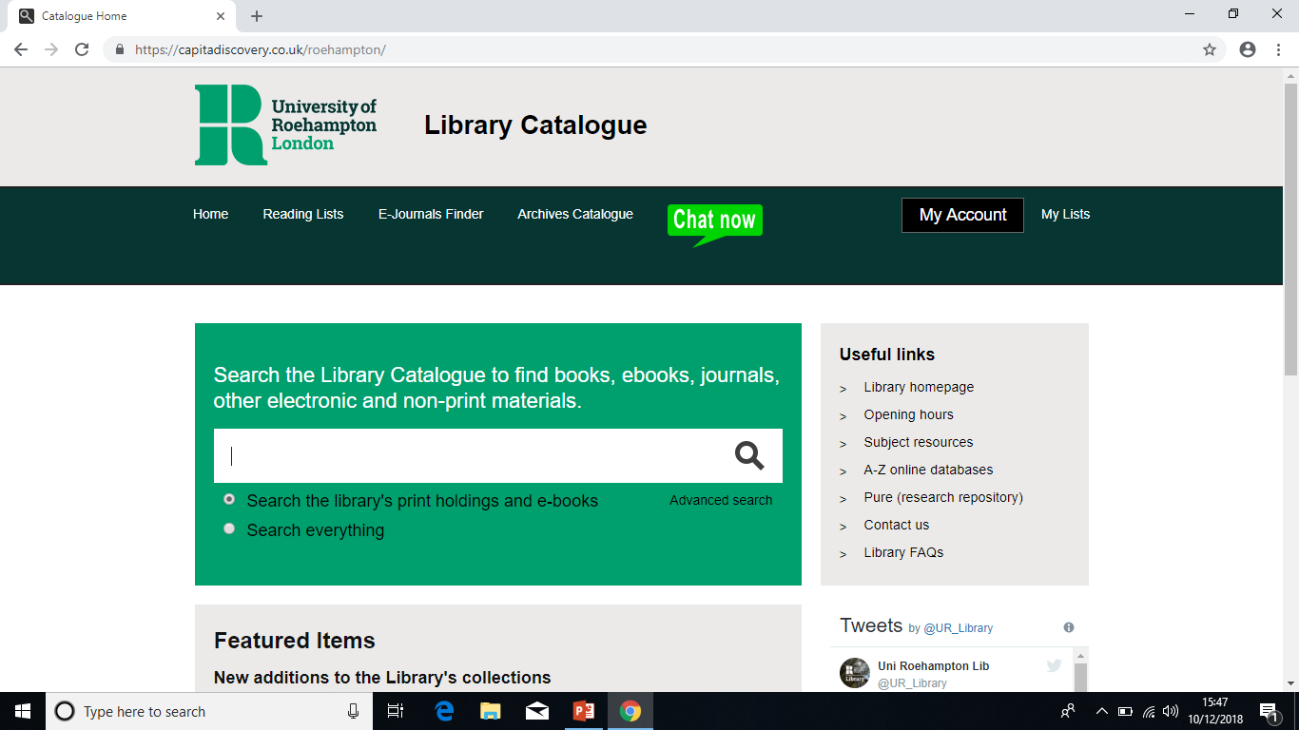

Slide 15
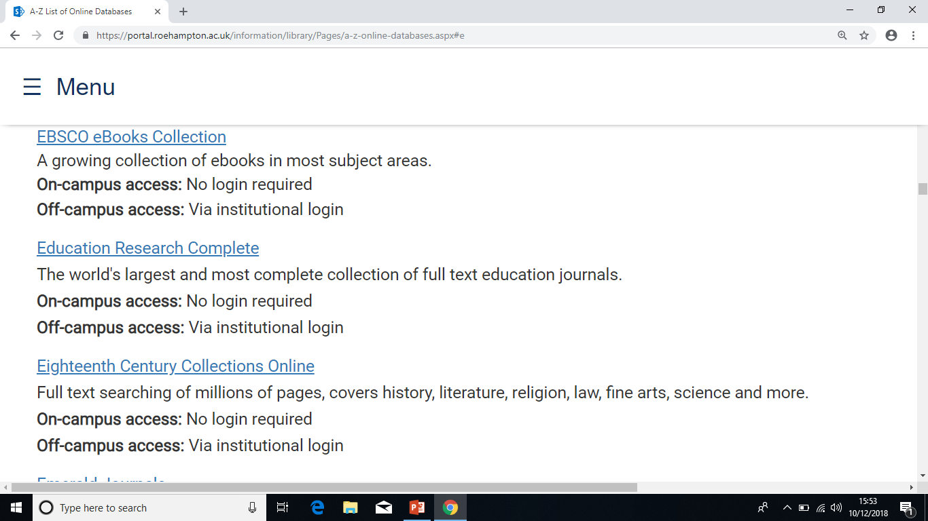

Slide 16
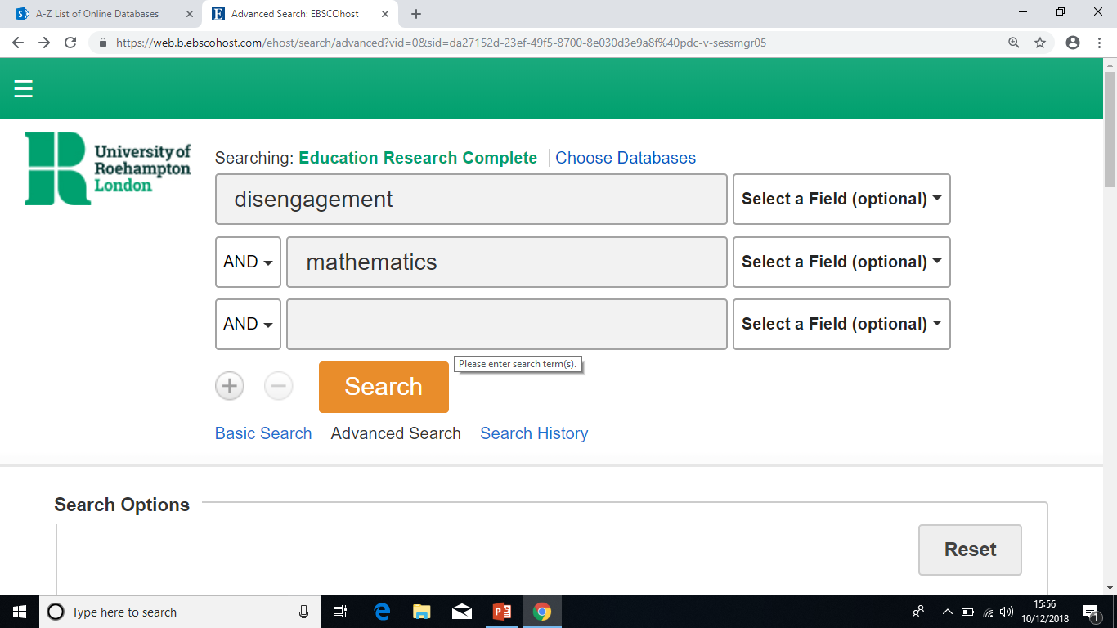

Slide 17
‘Understand literature and key concepts’

Slide 18
‘Research conducted by the OECD into student engagement focused on four factors: punctuality, attendance, sense of belonging and attitude towards school (OECD, 2013). These factors correlate to two ‘dimensions’ of engagement discussed in academic literature – behavioural engagement (the former two factors) and affective engagement (for the latter two)…’

Slide 19
Authoritative
Good
Sound – some criticality
Basic
Lacking in conceptual dimension

Slide 20
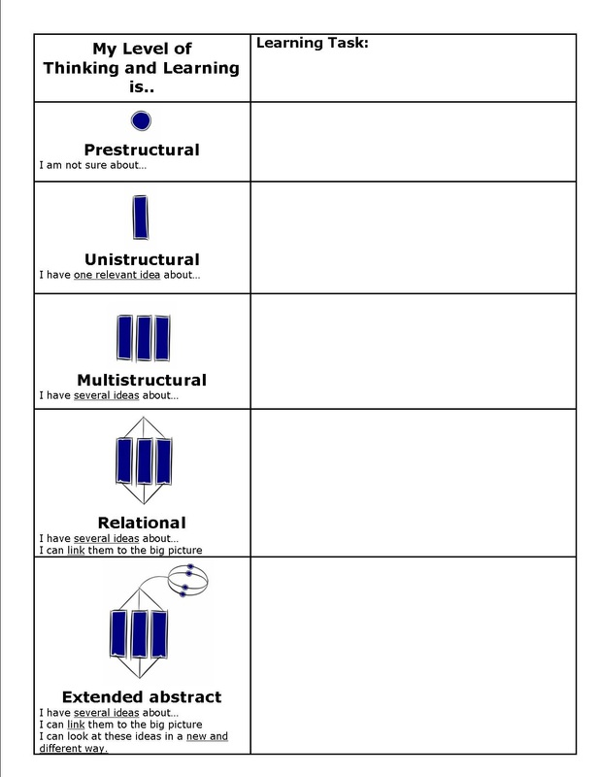

Slide 21
Step 3
Select approximately 5 strategies from the literature that you believe will help your chosen students to learn.

Slide 22


Slide 23
Step 4
Write - introduce your topic and critically evaluate your 5 strategies; explain which 2 or 3 strategies you will try out on specific students.
Notes:
Give students examples of strategies. This book has some great ideas.

Slide 24
Step 5
Reflect on your work, if necessary get feedback from peers and/or tutors.

Slide 25
Step 6
Teach a series of lessons using your chosen two or three strategies.

Slide 26
Step 7
Gather evidence which shows the impact of your strategies.

Slide 27
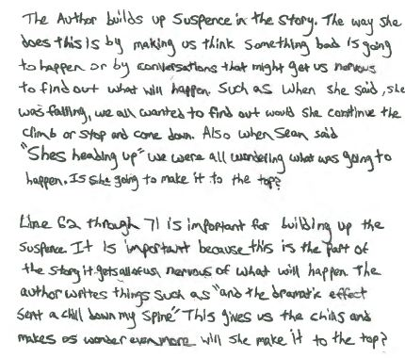
Notes:
Student work is a great way to collect evidence of your impact. You could also collect lesson observation notes made by your mentor.

Slide 28

Notes:
Evidence might be in the form of a transcribed recording.

Slide 29
Step 8
Write about the impact of your strategies (part B 1500 words).

Slide 30
Step 9
Blend and edit part A and B.
Check that you have ‘critical evaluation of practice by the application of theory’.

Slide 31
Step 10
Proof-read for coherence, SPaG and referencing.
Hand in your assignment via Turnitin on May 27th by 4.30 pm.

